Slide 1
Line Charts
By:Brianna Audette,
Cierra Torres,
Jason Pombo,
and Corey Souza

Slide 2
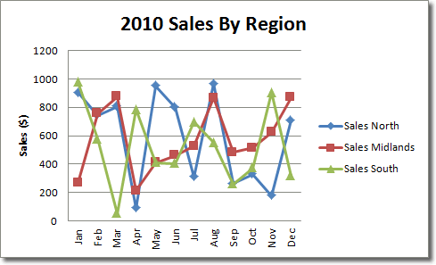
Example of a line chart

Slide 3
What you can use best for in a line chart is the rise and fall in stocks and with sale prices.
A line chart is best used to visualize a trend in data over intervals of time.
Line graphs allow us to see overall trends such as an increase or decrease in data over time. They are used to display data or information that changes continuously over time.

Slide 4
Go to insert, and click on line. Different styles of line charts will come up, you can use anyone you want.

Slide 5
After inserting the chart, tabs will appear saying Design, Layout, and Format. You can choose any color you want and the layout of the chart.

